Slide 1
IPFS Analytics
Michael Gagliano | Eric VanMeerhaeghe

Slide 2
Presentation Outline
Project Overview and Goals
Results and Key Findings
Recommendations
Notes:
May require more than one slide

Slide 3
Project Overview
Objectives:
Determine what factors lead to premature loan cancellation, given 3 years of provided loan data.
Make data-driven recommendations to executives based on findings of analysis.
Focus of Analysis:
What are the factors that explain loan cancellation?
Are there policy implications/changes in business rules that are necessary based on these findings?
What actions can IPFS take to mitigate future loan cancellation given the findings of this analysis?
Value-add(s) for IPFS:
Minimizing cancellations accomplishes:
Agents have more stability in their book of business (Good for employees)
Difference in earned premium can be re-invested in business/distributed among shareholders (Good for investors)
More careful underwriting -> preventing company loss of income (Good for the company; Reduce insolvency risk)
Notes:
May require more than one slide

Slide 4
Results and Key Findings
Cancellations Over Time
6 Most Important Predictors of Cancellation with Visualizations
Notes:
May require more than one slide

Slide 5
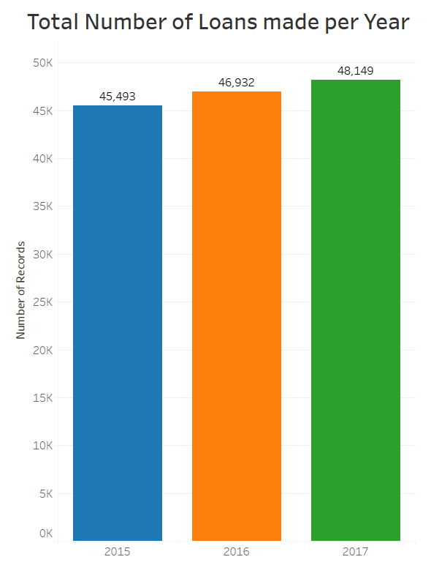
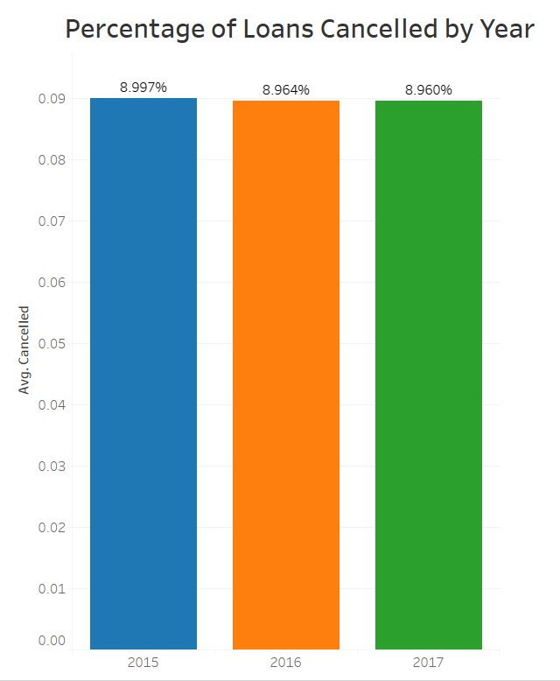
Cancellations Over Time
These figures show the total number of loans made per year, and the percentage of loans that cancelled each year in this dataset.
Loan Cancellation rate hovers around 8.9%, while total loans made increase year over year.

Slide 6
6 Most Important Predictors of Cancellation
Borrower Web Registration
Borrower uses Autopayments
Borrower Registered for E-Forms
Loan Amount/Premium
Borrower Classification/Industry
Borrower Credit Score

Slide 7
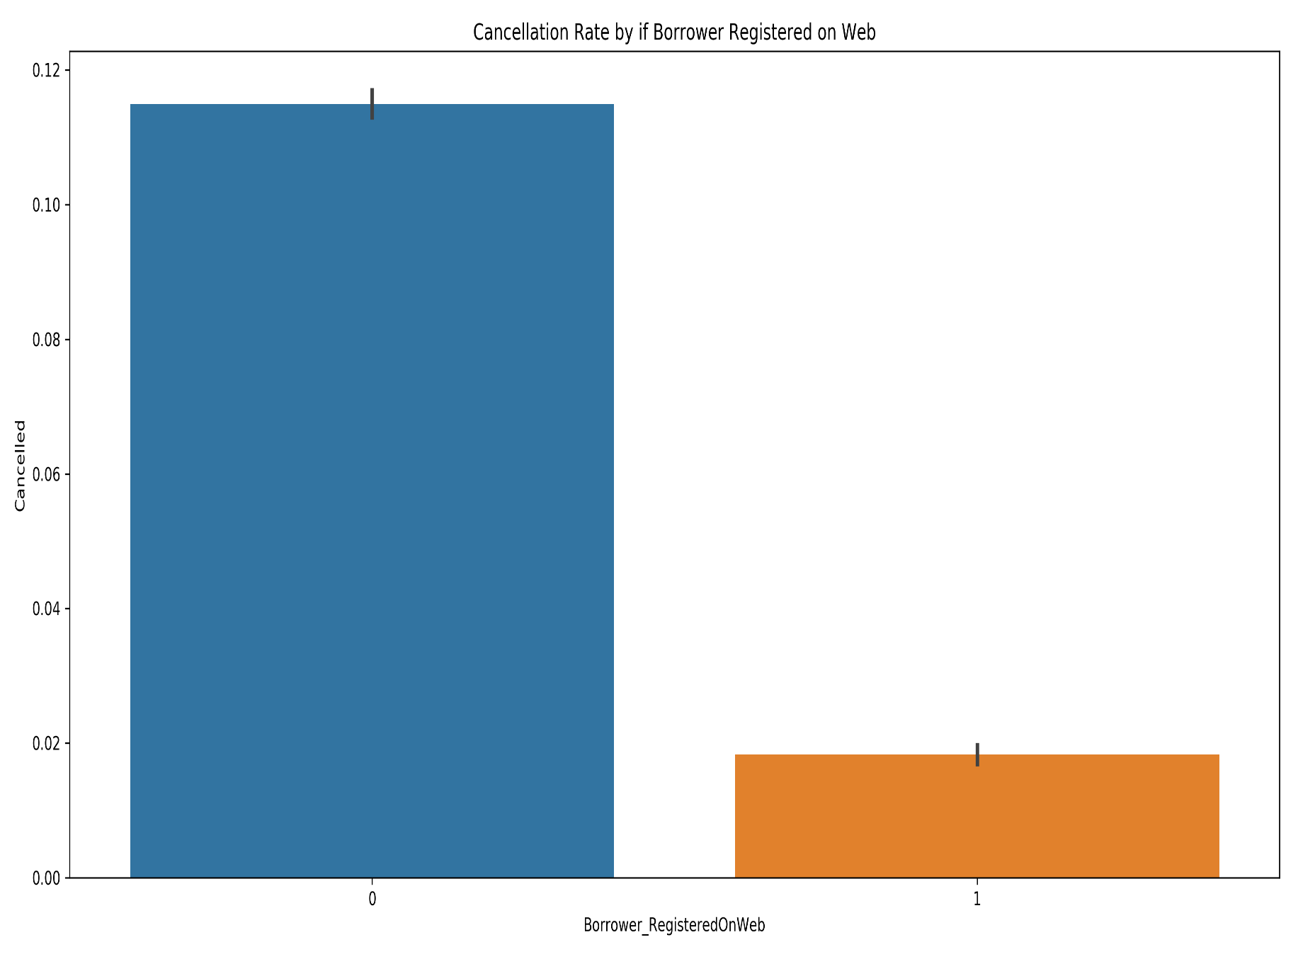
Borrower Web Registration and Loan Cancellation
Borrowers who registered on the web cancelled far less often

Slide 8
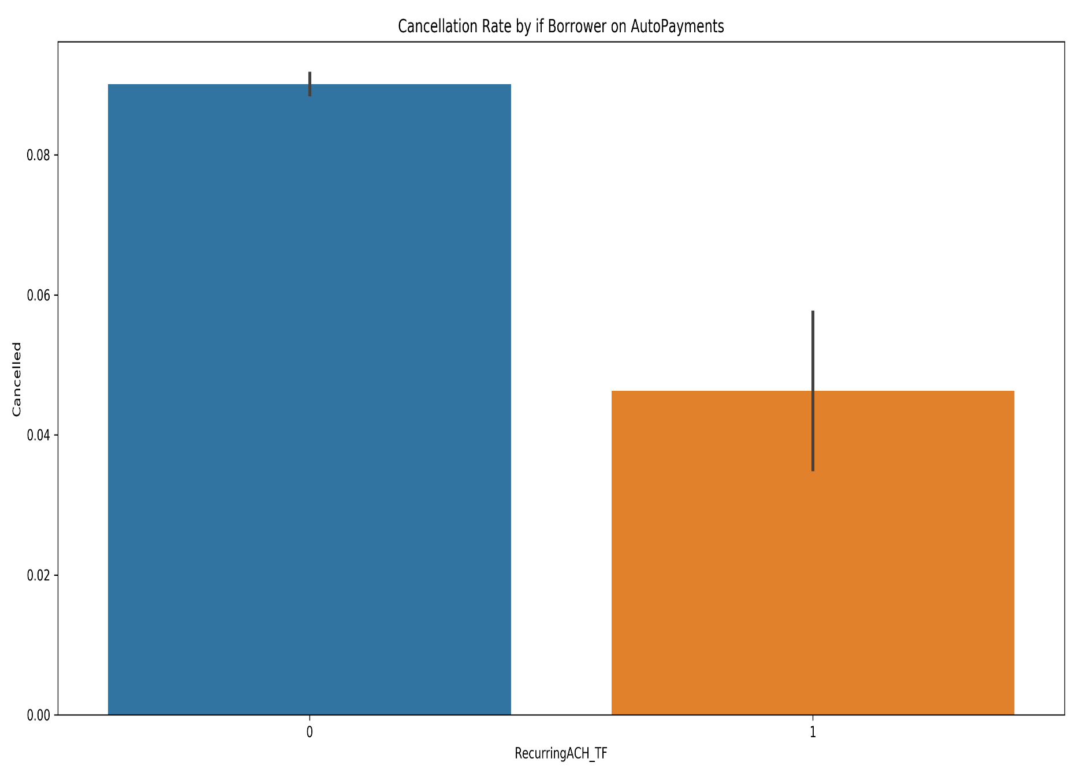
Borrower Autopayments and Cancellation
Borrowers who used autopayments to pay their loan cancelled at a lower rate than those that did not use autopay.

Slide 9
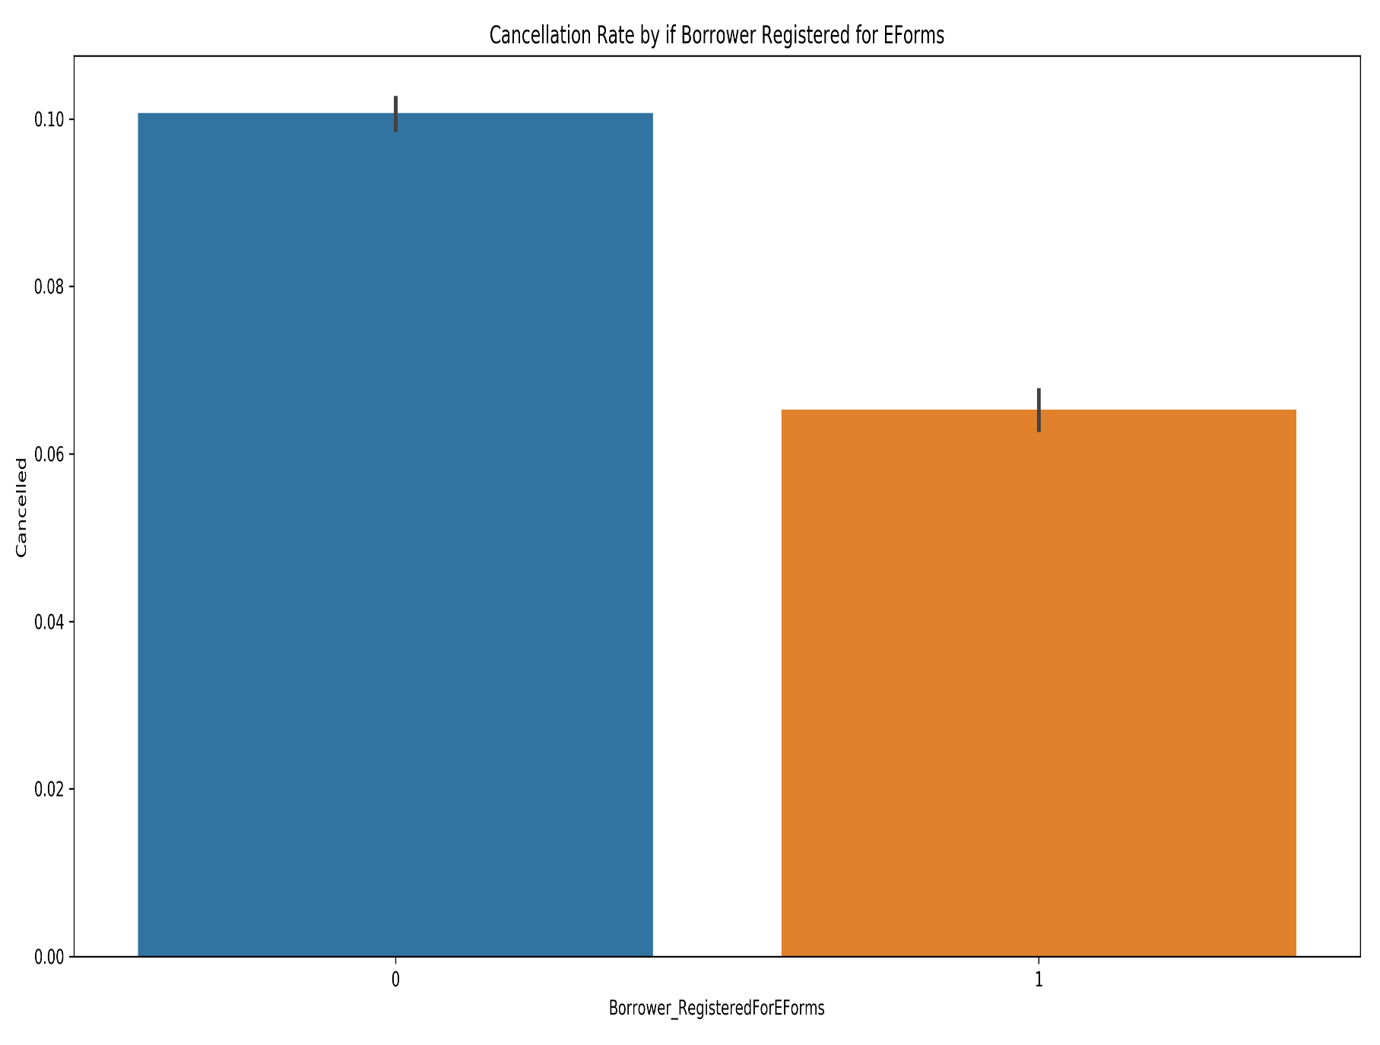
Borrower E-Forms and Cancellation
Borrowers registered for E-Forms tended to cancel less often.

Slide 10
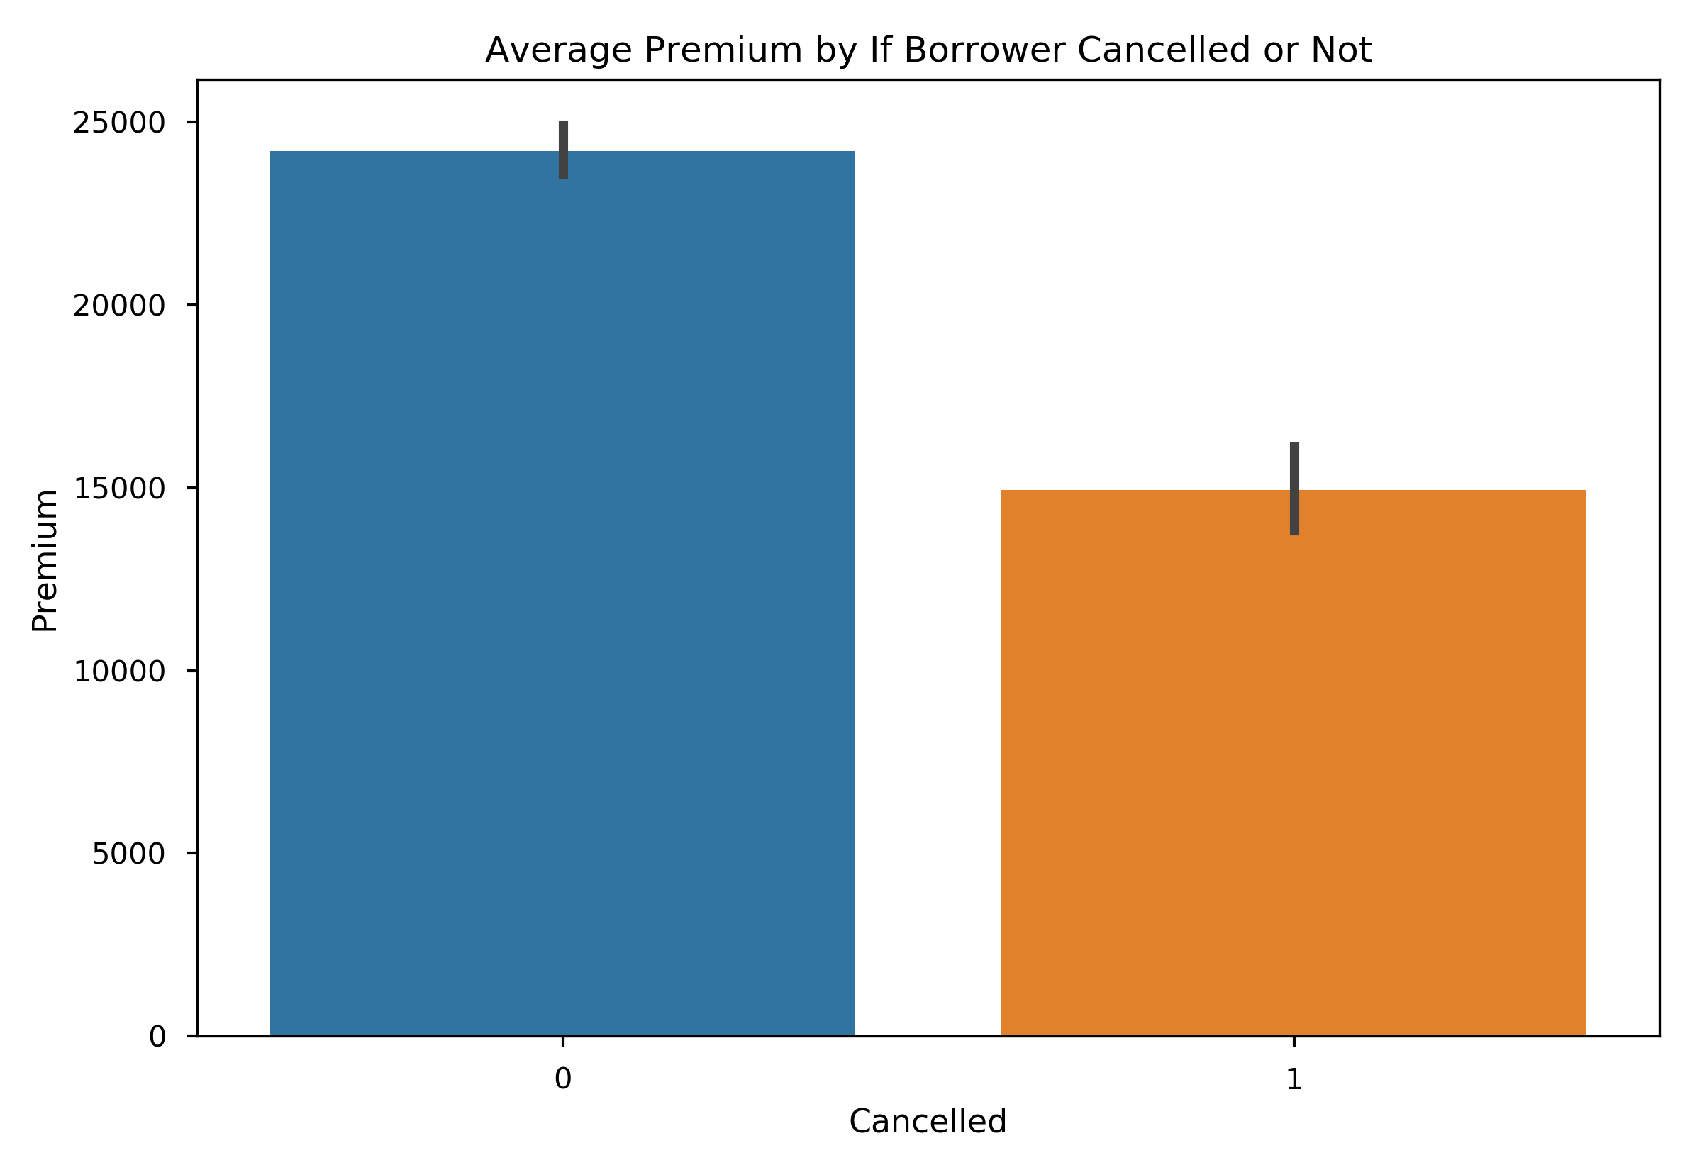
Loan Amount/Premium and Cancellation
Borrowers with higher premiums cancelled less often than borrowers with lower premiums

Slide 11
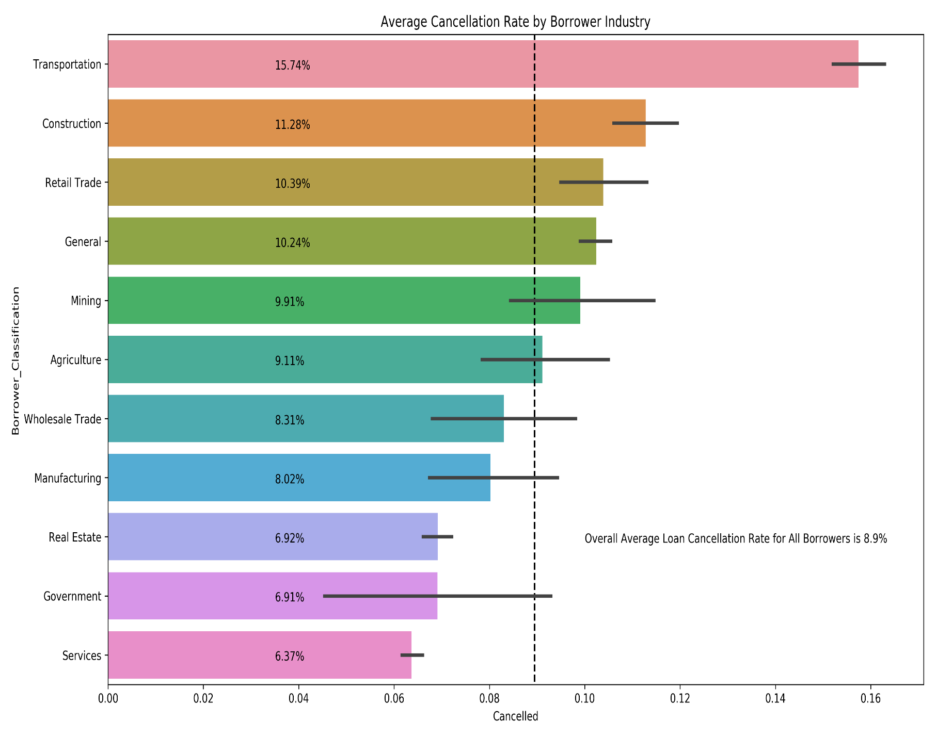
Borrower Industry/Classification and Cancellation
Some industries tend to cancel more than others, specifically borrowers in Transportation cancel disproportionately higher than others.
Government, Services, and Real Estate cancel less often than average.

Slide 12
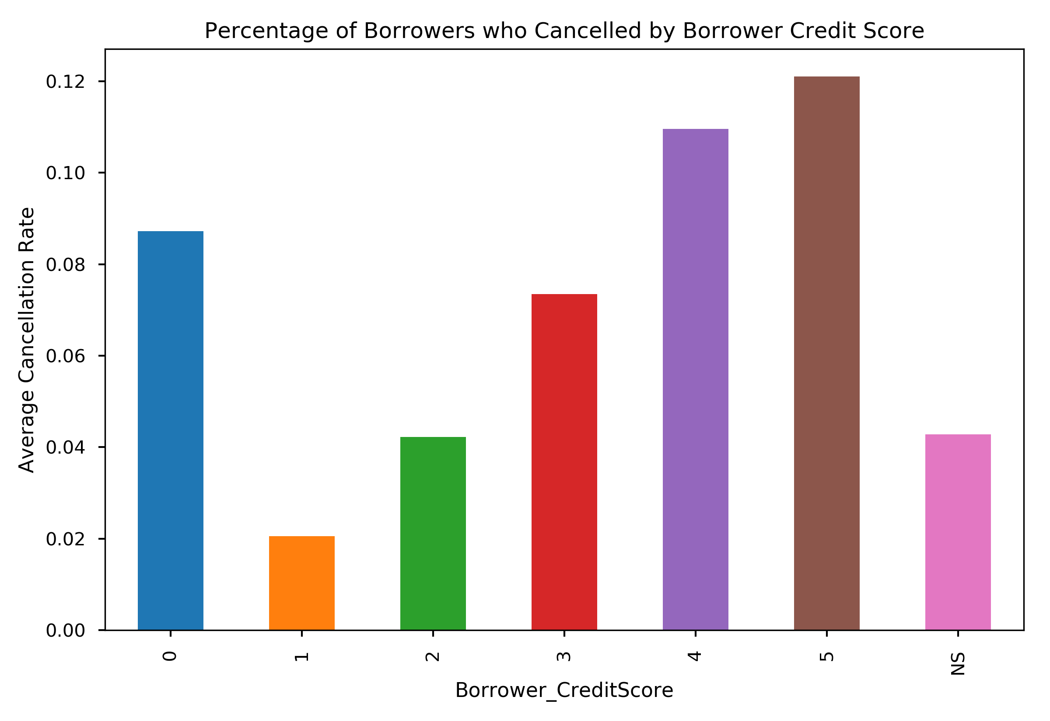
Borrower Credit Score and Cancellations
Borrowers with credit scores in categories 1,2 and 3 cancelled less frequently than average.

Slide 13
Summary of Findings
A potential profile of a safe borrower is as follows:
Borrower Registers on the web and uses the internet to service their loan/get updates about their loan
Borrower uses autopayments to pay their loan off
Borrower is financially well off/has access to capital
Borrower does not work in transportation or construction
Borrower has average to great credit
A potential profile of a risky borrower is as follows:
Borrower does not use internet to service loan/receives no electronic communications about their loan
Borrower does not use autopayments
Borrower takes out a smaller loan than average, possibly less access to capital
Borrower works in transportation or construction
Borrower has poor or no credit

Slide 14
Recommendations
Encourage or Require Borrowers to register on the web and use E-Forms.
Encourage or Require Borrowers to use autopayments
More thorough and detailed vetting of borrowers wanting smaller loans
More thorough and detailed vetting of borrowers with poor credit scores
More strict requirements for borrowers in Transportation or Construction

Slide 15
Recap
Loan Cancellation Rate has remained static over time despite increased loan volume.
6 Most Important Variables are:
Borrower Web Registration
Borrower uses Autopayments
Borrower Registered for E-Forms
Loan Amount/Premium
Borrower Classification/Industry
Borrower Credit Score
We recommend that IPFS enact the following if possible:
Encourage or Require Borrowers to register on the web, use E-Forms, and use autopay.
More thorough and detailed vetting of borrowers who meet some or all of the criteria described previously that characterize a risky borrower.
More stringent loan terms for borrowers in Transportation or Construction.
Notes:
May require more than one slide

Slide 16
Questions?

Slide 17
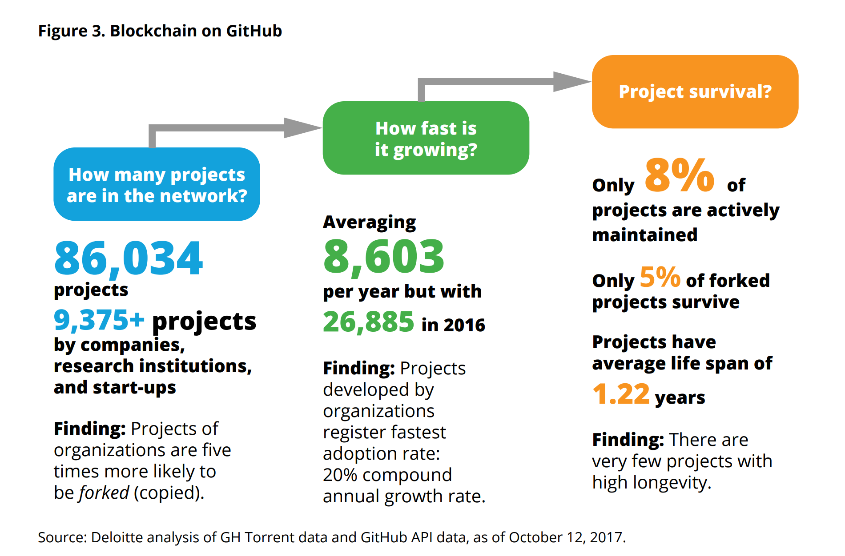
Evaluation
How many loan PFS agreements overall?
How fast is it growing?
PFS agreement survival?
Notes:
May require more than one slide

